Slide 1


Data Modelling in Azure Cosmos DB
Will Velida
Software Engineer
Microsoft Data Platform MVP
Notes:
Hi there, My name is Will Velida, I’m a Software Engineer and Microsoft Data Platform MVP based in Auckland New Zealand and in this video, I’ll be talking about Data Modelling in Azure Cosmos DB.

Slide 2
Where are we?
Modelling our data
Understanding Partitioning
Understanding Throughput
Database and Container Design
Understanding Global Distribution
Notes:
So in our last video, we discussed what Cosmos DB is, what type of applications we might use Cosmos DB for and we went through a quick demonstration on how we can set up a Azure Cosmos Account via the Azure Portal
Now let’s dive into our list of topics that we need to understand when designing applications for Cosmos DB. In this video, we’ll be tackling the first topic, modelling the data we’ll be storing inside Cosmos DB for our application.

Slide 3

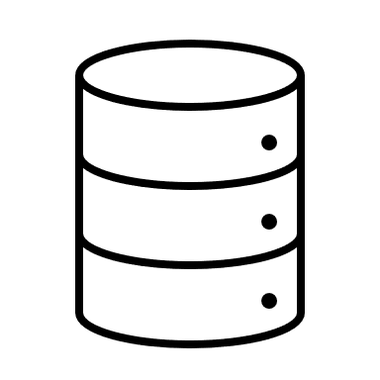

Initial Questions
Why should I care about data modelling in Cosmos DB?
How is it different to relational database modelling?
How do we express relationships in our data?
Notes:
When we’re modelling our data for our applications that will use Cosmos DB, we might ask ourselves the following questions:
Why should I care about data modelling in Cosmos DB when it is a schema-free data store?
How is data modelling different in Cosmos DB compared to what data modelling is when we’re developing applications that use relational data stores?
How do we express relationships in our data store bearing in mind that Cosmos DB is non-relational?

Slide 4




Scenario: Online Book Store
Notes:
To answer these questions, we’ll use an example of an online book store. So in this application we’d store information about books, authors of those books and in this example we could hold information on reviews of those books that users or customers would make on particular books

Slide 5


Relational Data Model
Authors
Id
FirstName
LastName
BirthDate
Book
Id
AuthorId
BookName
BookDescription
BookGenre
ReleaseDate
AverageRating
Price
Reviews
Id
BookId
Rating
RatingDescription
Primary Key
Foreign Key
Notes:
So lets take a look at how this might be modelling using a relational database. With relational data stores, we would normalize our data and break each entity into discrete components. So here a book can have an author, books can have multiple reviews, Authors can have write multiple books.
The idea behind normalization is to avoid storing redundant data and refer to other data, so for example if we wanted to retrieve all the books that were written by a particular author (next slide)

Slide 6
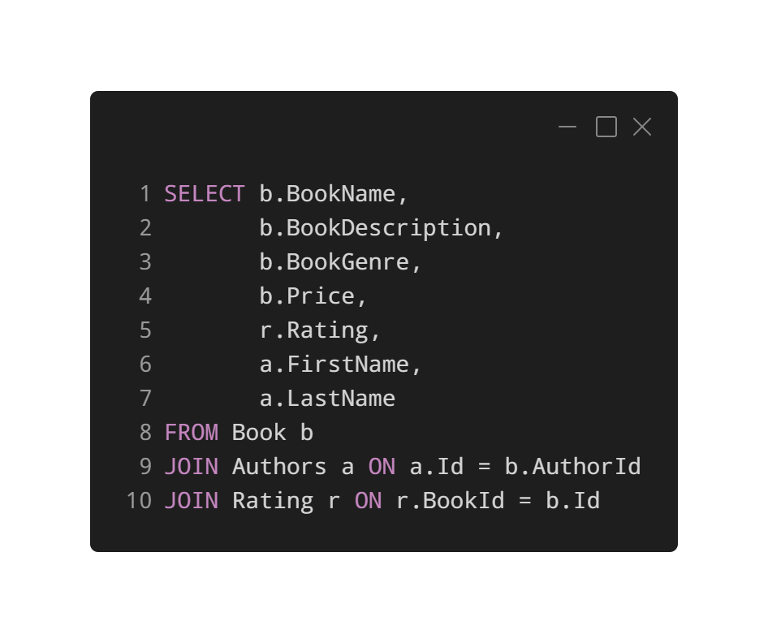
SQL: Retrieving all books for a Author
Normalizing data avoids storing redundant data.
Refer to other data.
Implement Joins to denormalize the data back to us.
Updating information would require write operations across different individual tables.
Notes:
We would have to write the following SQL query, essentially to get a book for an associated author along with the ratings of the books that they’ve written, we’d need to use Joins to denormalize the data back to us whenever we would want to see that.
Alternatively, updating all this information would require us to perform write operations across different individual tables.
Now you might be watching this thinking, why wouldn’t we take this same approach in Cosmos DB? It makes sense to keep discrete entities in separate tables and you’ve said that Cosmos DB doesn’t care about document schema, so why should this be any different in Cosmos?

Slide 7
Problems with this approach in Cosmos DB
No support for JOINs across containers
Throughput considerations.
Multiple, Messy Operations.
Notes:
Well there are a couple of problems with having separate tables (or containers as they are known in Cosmos).
Cosmos DB doesn’t have support for joins across containers. So right from the start, you won’t be able to join data sitting in one container to data sitting in another.
Taking this approach also has cost repercussions, not just technical ones. We haven’t talked about Throughput yet, but depending on how you provision throughput on your databases and collections in Cosmos DB, having a bunch of different collections may not be the most efficient approach to take.
Finally, performing operations across these different collections will be messy. You may have to perform SQL like joins on your data in memory, which may require multiple reads. Then trying to update your data all over the place will mean you’ll have to perform multiple writes all over the place.

Slide 8
How do we model our data?
Notes:
So with all this in mind, you might be scratching your head thinking, how do we actually model data in Cosmos DB?

Slide 9
Data Modelling Options
Embedding
Referencing
Hybrid
Document Types
Notes:
Well, with Cosmos DB, we have a few options at our disposal.
We can use Embedding in our documents.
We can reference data in some documents that reference to data in other documents.
We can use a bit of both using a Hybrid approach
Or we can be really ambitious by storing different document types within the same container.
Let’s take a look at embedding first

Slide 10
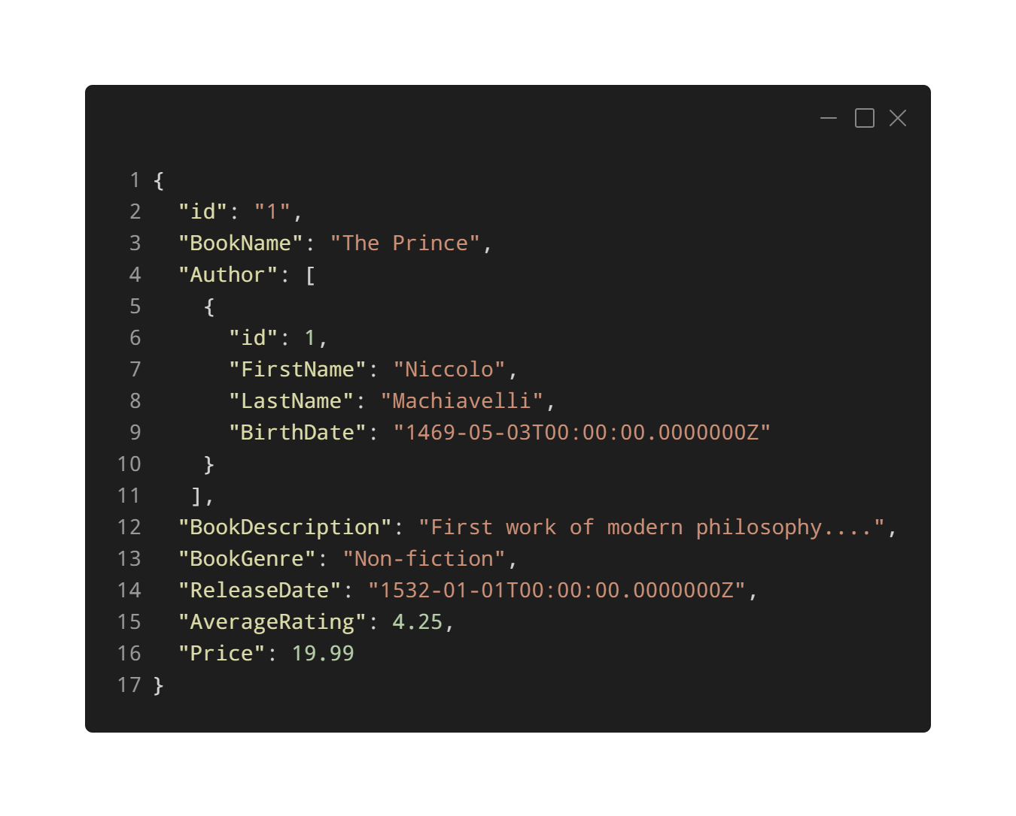
Embedding Data
Notes:
With Embedding, we treat entities in our model as sel-contained items in our documents. So here, I have a Book, with an Author entity embedded inside our Book document. Now, all our information related to this book is now embedded into a single document. So querying for this book doesn’t require any elaborate joins to multiple tables.
One document, one collection, one request. Getting this book is a single read operation. Updating it is a single write operation. Nice and simple ☺

Slide 11
When can we use embedding?
Contained Relationships between entities.
One-to-few relationships between entities.
Embedded data changes infrequently.
Embedded data doesn’t grow without bound.
Embedded data is queried frequently together.
Notes:
The general guidelines for using embedding are straight forward. Read points on screen.
Now let’s take a look at referencing.

Slide 12
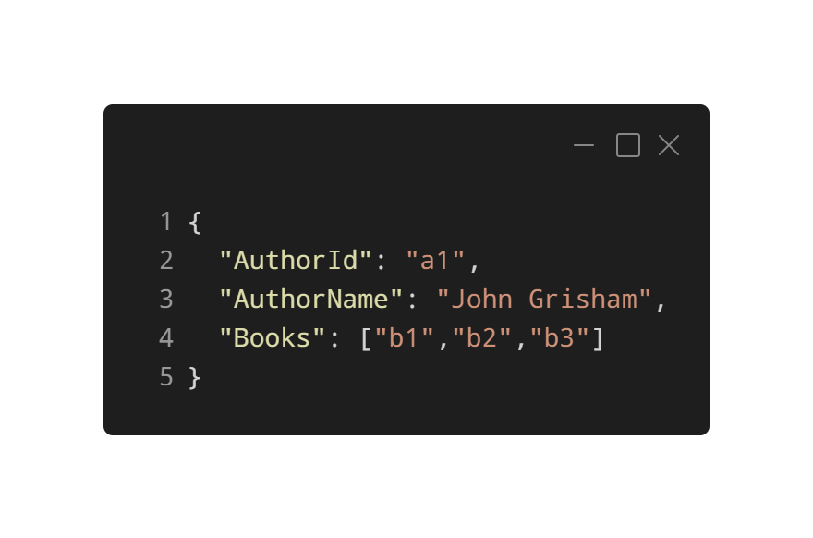
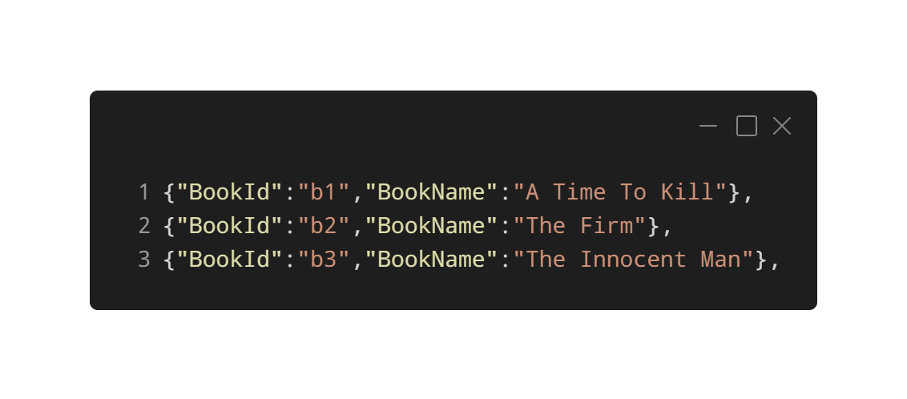
Referencing Data
Notes:
Now bear in mind that despite being non-relational, we will still have relationships in our data that we store inside Cosmos DB. Now if we need complex relationships, it would be better if we stick to relational data stores, but if we have simple relationships, we can use referencing.
Let’s take the following example, now some authors in our application might publish more books than others and it may be impractical to store all the books they’ve written in the same document. So we could add a reference to the books they have written in another document. This approach is great if we have arrays in our data that are unbounded, or in other words, can grow to an unlimited size.
We can even avoid having the book array in our author document here by adding a reference to the author within our book document. So with referencing, we have a couple of options at our disposal to optimize our data models.

Slide 13
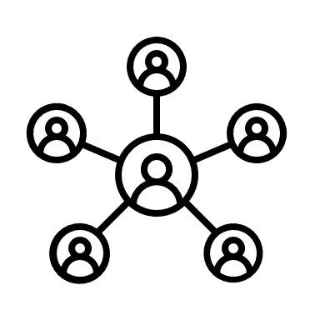


When should we use Referencing?
Represents one-to-many relationships.
Represents many-to-many relationships.
Related data changes frequently.
Reference data can grow without bound.
Notes:
Here are the guidelines we should follow if we want to use referencing in our data.
If we have one to many relationships or many-to-many relationships, we can benefit from referencing, particular when it comes to heavy duty write operations.
If the related data changes frequently, then referencing the frequently changing data would be better than embedding it.
If our referenced data grows without bound, that means the referenced data has a unlimited size, then referencing this data is a good approach to take.
Of course, thanks to the schema-agnostic nature of Cosmos DB, we aren’t limited to choosing only one approach, we can use hybrid of both embedding and referencing depending on the nature of our data.

Slide 14
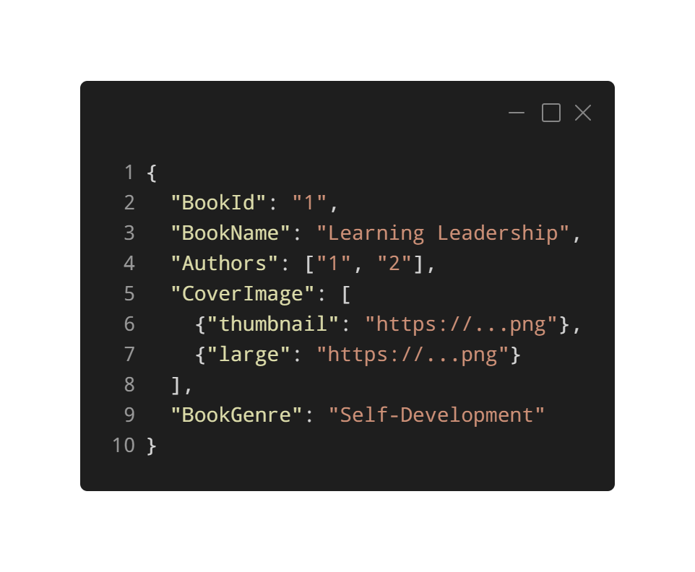
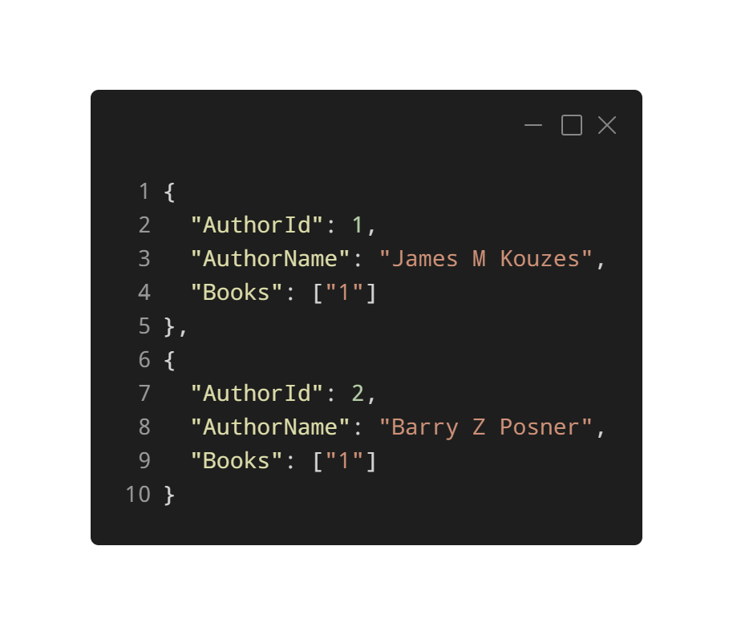
Can we mix and match?
Notes:
Take the following example. Here we’ve got a book document that embeds data that stores our Cover Image of our Book and then uses referencing to reference the authors of our book. Using this approach, we can make a single write operation to update information about our books without making updates to our authors and if we need to make an update to our authors, we can perform a single write operation on our author document.
With this approach, we’re referencing our author Id in our book document. If we wanted to be really adventoures, we could insert both these documents within the same container.

Slide 15
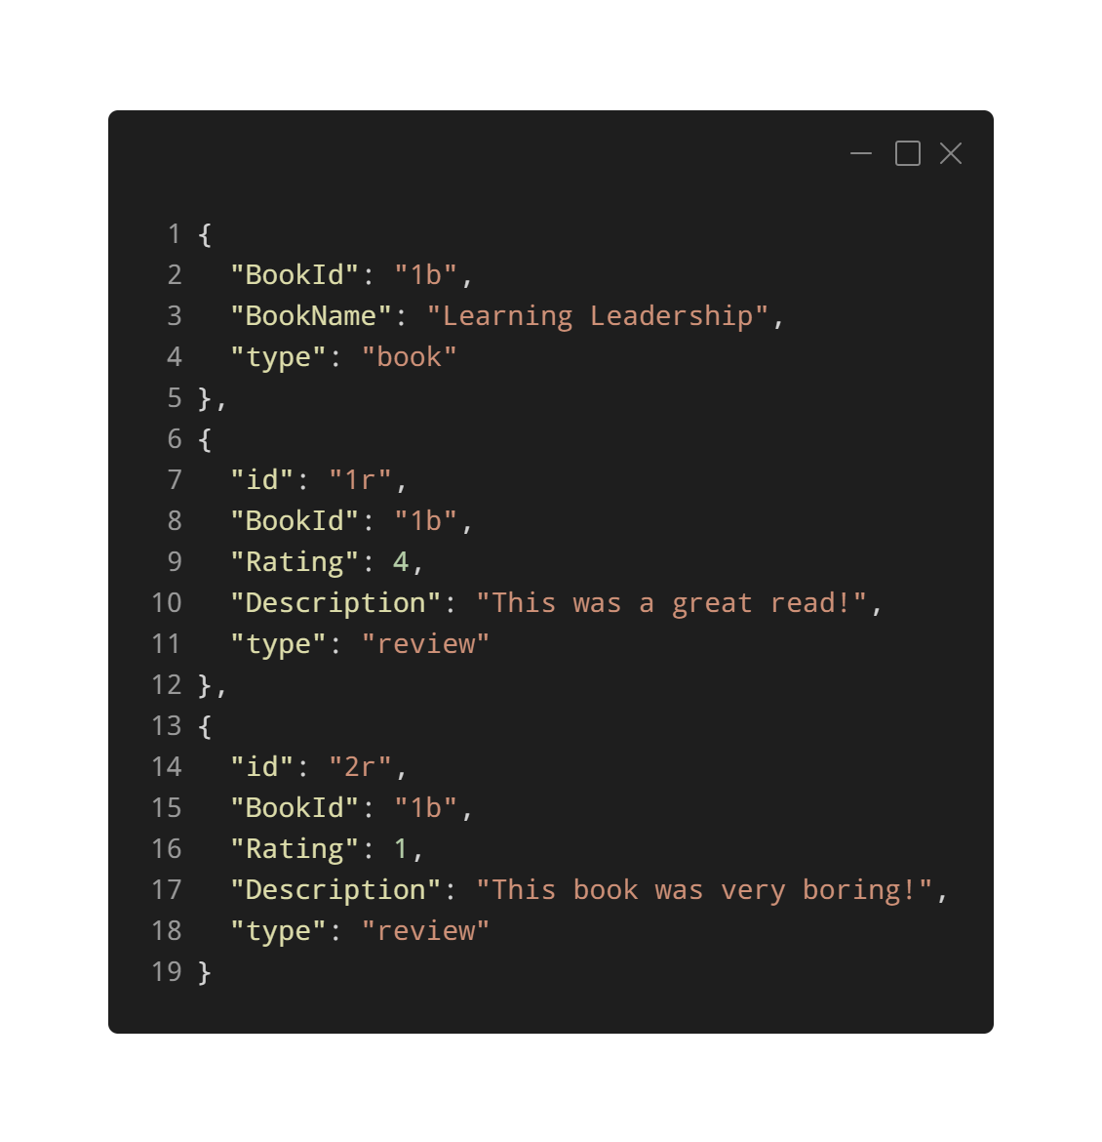
Different Document Types
Notes:
Now I suspect you might be thinking that I’m being a little too ambitious here, but let’s take the following example. Here we have Books and Reviews within the same container.
We have a Book document at the top here, followed by two review documents that have a reference to the book id as part of their schema. What’s important to note here is that we have a property called type that differentiates between our documents.
Using this method, we can query the same container and then perform inner joins on our documents if we wanted to see all the reviews of a particular book.
We would take this approach when we have multiple related documents that sit within the same partition inside our collection. I’ll talk about partitioning in my next video.

Slide 16
What next?
Modelling our data
Understanding Partitioning
Understanding Throughput
Database and Container Design
Understanding Global Distribution
Notes:
So as you can see, even though we have stepped away from our relational data store into a whole new world, I hope you understand that being mindful of your data models is still vital in Cosmos DB and that you have a few methods up your sleeve to ensure that your data model is optimized for your applications.
Now that we understand the importance of data modelling in Azure Cosmos DB, it’s now time to discuss how partitioning works in Cosmos DB. This is a vital concept to learn, as understanding partitioning will really help you to build scalable application so make sure you stick around for that video.

Slide 17
Thanks for Listening
@willvelida
https://www.linkedin.com/in/willvelida/
Notes:
Thanks for listening! As always, if you have any questions, please feel free to ask me in the comments or reach out to me on Twitter or LinkedIn. See you next time.

